Slide 1
Pittcon 2021 1st Chair/Chair-elect meeting
20200716

Slide 2
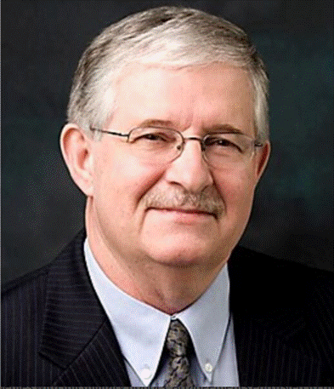
Ed Ladner
2009 Pittcon President
2001-2 Chair SSP
2000-1 Chair-elect SSP
Ed will be very much missed by us all…
a great friend and caring committee member

Slide 3
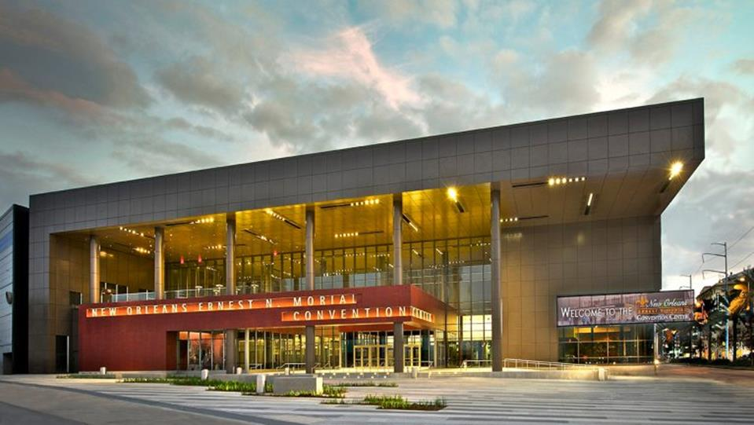
Dramatically Changing Landscape
New bus, Taxi, Uber & Lyft Terminal
New Pedestrian Walkway
Video Signage
Water bottle filling stations
All hotels within 1 mile of Conv. Center
Pittcon was last large show
Pittcon will be first post Covid large show

Slide 4
A New Normal
Pittcon 2020 was the last
pre-Covid Conference
You will ever attend!

Slide 5
Status Updates
Pittcon 2020
WU/KO cancelled
WU meeting (Teams) will be 7/30/2020
Pittcon 2021
A General Committee KO (Virtual) meeting will be held in August
PC Team working on hybrid conference for 2021
Contract re-negotiations – existing contracts
New Contracts and Purchases
Push as late a possible before committeing
Contracts: Verify “escape clause” in event of Covid-related cancellation
Lease re-negotiation underway
Financial Infrastructure & Process Optimization
2021 Budget released to Chairs
2021 Roster ready for release
2021 Expo Status
470 booth
5 seminar rooms
2021 Program status
40 symposia accepted
15 award symposia
Call for papers open

Slide 6
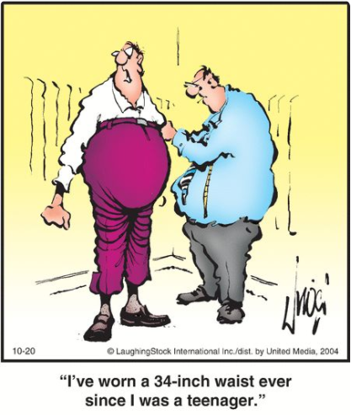
Time for New Ideas & Processes

Slide 7
Financial Process Optimization
Benchmarking study completed in June
A number of opportunities for improvement were identified
The above improvements (if implemented) should reduce time required for accounting/reporting/closing processes
A next phase project was outlined
QB online
QB training and certification
New Chart of Accounts
Revised coding
Monthly accounting process outline
Optimized closing processes
Optimized reporting processes
To start late July, early August.
On-site consulting visits commence Aug 12
Three month duration target

Slide 8
Office Staff/Committee Expectations
Joe Cox – dedicated to:
QB online certification/conversion to QB on-line
Implementing revised Chart of Accounts/coding
Developing/documenting new processes and schedules
Shelley Simpson-Forget
Hybrid Conference (w/Scott)
Program interface updates (A2Z)
No Insite, warrant, expense, etc. calls to Joe
No Office, Teams, computer, etc. calls/visits to Shelley or Scott
Office door will remain locked. No un-announced distractions

Slide 9
Your Toolkit
Anti-virus protection
Do not open attachments unless you know the source
www.webroot.com
E-mail
Committee Chairs/Chair-elects
No company info/taglines in Pittcon e-mail communications
All e-mail, Teams, software questions to John Sember not Shelley
Meetings
Video Meetings – MS Teams
Conference Calling
www.freeconferencecall.com
Conference office – up to 20
Rec333 – larger meetings (30-40)
Business Cards
Valarie Cassidy

Slide 10
Your Toolkit
The Pittcon Website
http://www.Pittcon.org
E-mail group addresses
Warrant, Personal expense, site trip expense procedures
E-mail
Committee Chairs/Chair-elects
No company info/taglines in Pittcon e-mail communications
All e-mail, Teams, software questions to John Sember not Shelley
SD-Insite
All questions to Eli Absey not Joe Cox
Any help requests not addressed above
Call Tammy

Slide 11
Your Toolkit
Training (Sember/Varine)
Outlook E-mail
Committee Chairs
No company info/taglines in Pittcon e-mail communications
MS Teams
Expenses/Warrants
See training at Pittcon.org
Under “Expenses”

Slide 12
Your Toolkit
2020 Invoice Detail Spreadsheet
Review charges from 2020
Decide what you really need for 2021
Identify lower cost options (if available)
Identify and communicate what you do not need
In contract specifications with vendors
When Office equipment, A-V, Catering, etc. request forms go out
Your Budgets
Accomplish your as cost effectively as possible
Beat your budget, if more $ needed, make a business case
Communicate special needs if they arise

Slide 13
2021 Schedule

Slide 14
Pittcon 2021 Schedule
Everyone done, back to Pittsburgh, on/by Thursday
Impacts ALL Committees (GES, A-V needs)
Most Impacted Committees (vendor contracts)
A-V
Committee Arrangements
Communications Technology
Expo
Housing/Transportation
Short Courses
Registration
Security
Program
Activities
PIE

Slide 15
Help Chain
Stuff Happens
Reach out for help, if needed
Reach out BEFORE your deadline
Your Help Chain:
Your committee
Neal Dando
Eli Absey
Jonell Kerkhoff

Slide 16
Don’t Hesitate to Question
We’re in this together

