Slide 1
Exhibitor Planning Meeting:
I got my booth number…now what?

Slide 2
Exposition
Tammy Yallum & Stephanie Christman

Slide 3
Exposition Contacts
Chair
Charlie Holifield & Jan Pifer
holifield@Pittcon.org
pifer@Pittcon.org
Chair-Elect
Jonell Kerkhoff
kerkhoff@Pittcon.org
Expo Coordinator
Stephanie Christman
christman@Pittcon.org
412-825-3220 x204
Expo Manager
Tammy Yallum
yallum@Pittcon.org
412-825-3220 x205

Slide 4
Official Service Contractors for Pittcon 2020
Advertising/Publicity – Pittcon Buzz/Pocket Guide /Pittcon Today
CE Communications Group LLC
Chuck Wilson: 570-476-3103 - cwilson@cnpnet.com
Audio Visual Rentals
AVPG
Joel Thomason: 504-581-2874 - joel@avpg.com
Catering
SAVOR
Morgan Lamb: 312-791-7261 - mlamb@mccormickplace.com
Floral Services
FloralExhibits
773-277-1888 - info@floralexhibits.com
Computer Rentals
SmartSource
Brittney Krailler: 312-710-3353 - bkrailler@smartsourcerentals.com
Communication Services – Internet/Networking/Telephone
McCormick Place
312-791-6113 - technology@mccormickplace.com
Carpet/Furniture/Electric/Graphics/Booth Rentals
GES, General Contractor Services
702-515-5970
Convention Center
McCormick Place
312-791-7000

Slide 5
Official Service Contractors for Pittcon 2020
Housing
OnPeak
855-992-3353 - pittcon@onpeak.com
Travel
Travel Market Vacations
Sarah Applin: 262-241-4040 - sarah@travelmarketvacations.com
Lead Retrieval
Experient
Marie Zinnert: 888.270.8467 / marie.zinnert@experient-inc.com
Liability Insurance
Buttine Exhibition & Event Insurance
Kendra Reilly Monahan: 212-867-3642 - kar@buttine.com
Photography Services
Roy Engelbrecht Photography
Roy Engelbrecht: 412-551-2230 - roy@royephoto.com
Registration
Experient
240-439-2554 - registration@pittcon.org
Security
Special Operations Associates
John Theel: 702-386-8065 - jtheel@soasecurity.com
Shipping & Customs
Agility Fairs & Events
Margaret Churchill: 714-617-6675 - mchurchill@agility.com

Slide 6
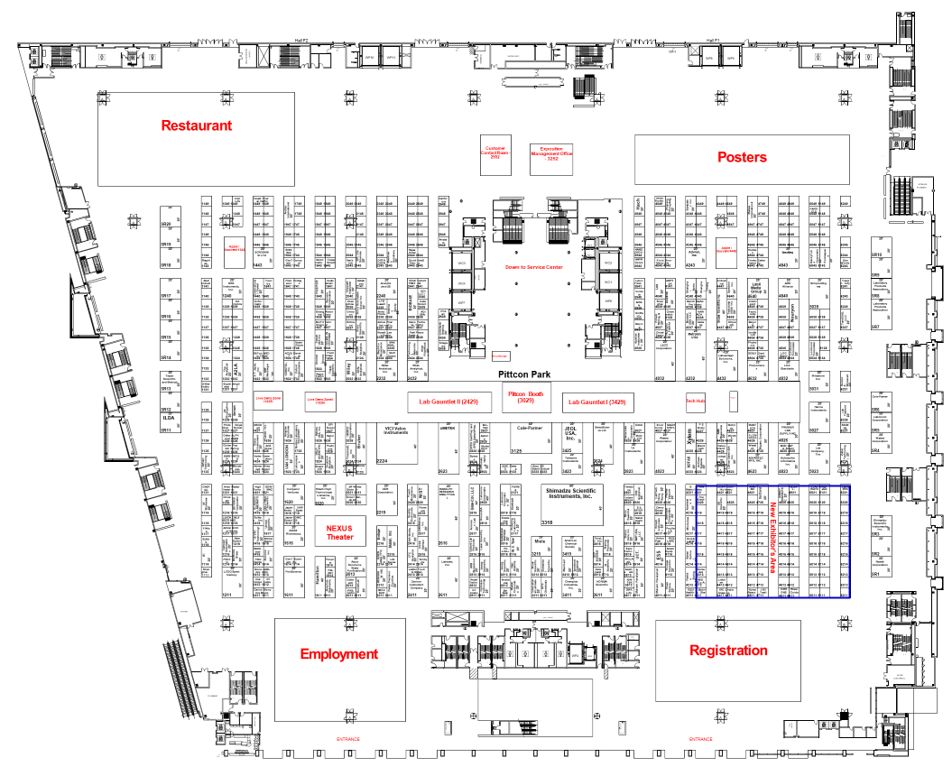
Entrance
Entrance

Slide 7
Important Items to Remember
Move in begins Thursday, Feb. 27 – Monday, March 2, 2020
Maximum height on any hanging banner – 36’ from the floor (top of banner)
All carpet MUST be installed no later than 5PM on Monday, March 2, 2020
Plastic, vinyl, and fabric that is less than ¼ inch in thickness and/or not sufficiently adhered to the floor are some examples of hazardous floor covering material and are not permitted to be used. Floor covering must cover the entire booth space.

Slide 8
Important Dates and Deadlines
NOVEMBER 2019
Monday, November 11, 2019
Balance of booth space payments due
Monday, November 18, 2019
Exhibitor Registration Opens
JANUARY 2020
Monday, January 6, 2020
Exhibitor Appointed Contractor form due
Hanging banner, specialized lighting and exhibit drawings are due to The Pittsburgh Conference for approval
Certificate of Insurance or signed Waiver & Release due to The Pittsburgh Conference
Deadline for reserving Lab Gauntlet and Demo Zone space
FEBRUARY 2020
Thursday, February 6, 2020
GES advance discount pricing deadline on carpet, furniture, electric, etc.
Last day for on-line advanced discount rate on Air & Water Services provided by McCormick Place
Last day for on-line advanced discount rate on Internet &Telephone Services provided by McCormick Place
Thursday, February 20, 2020
Last day that items can be received at the GES Advance Warehouse
Wednesday, February 26, 2020
GES standard pricing deadline

Slide 9
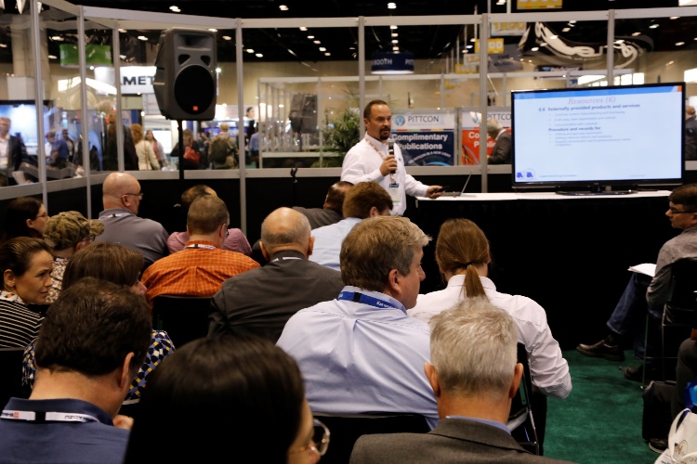
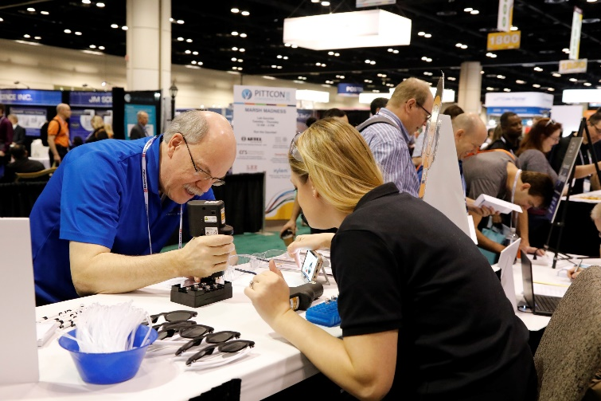
Engage with attendees on the Expo floor
DemoZones
- 25 to 30 minute live demo presentation of a product or service
- $300 / DemoZone
Lab Gauntlet
- A series of short, fun, one-minute challenges where attendees compete for prizes
- $300 / Lab Gauntlet
Nexus Theater
- A theater style setting that will be available for a 30 minute presentation focusing on a scientific topic of interest and cannot be a product or sales presentation
For more information visit our website at https://pittcon.org/ or contact Stephanie Christman via Christman@Pittcon.org

Slide 10
Meeting Space Options
Seminar Rooms
20x20’ units that hold approximately 40 people
Without ceiling = $7,500 OR with ceiling = $8,900
Customer Contact Rooms
10x10’ ($475) or 10x20’ ($700) room options
Rented on a 3 hour basis Tuesday – Thursday from 9:30am – 12:30pm or 1:00- 4:00pm
Meeting Space Rentals
20x20 ($1,700) units that hold approximately 40 people
Rented on a 3 ½ hour basis Tuesday – Thursday from 9:00am – 12:30pm or 1:00pm – 4:30pm
Utilize these options to meet with potential customers or employees
For more information visit our website at https://pittcon.org/ or contact Stephanie Christman via Christman@Pittcon.org

Slide 11
Questions:
Many of your questions can be answered by visiting our website at www.Pittcon.org

Slide 12
Registration
Tammy Yallum (speaking on behalf of Shelley Simpson)

Slide 13
Corporate Guest → Exhibitor Guest
Corporate Guest program is now retired.
We now have the Exhibitor Guest program.
Each 10x10 booth = 4 Exhibitor Guests
Exhibitor Guest = One Day Registration (Expo days only)
The Exhibitor Guest will choose an Expo day (Tues, Wed, or Thurs) during registration.
Please note that there is no longer a “free” Thursday
The Exhibitor Guest will have the option to upgrade to a full registration during the registration process and pay the difference.
The price difference will be based on the date they register to reflect either the deadline rate or the full rate.
Additional questions regarding Exhibitor Guests? Contact Shelley at simpson@pittcon.org

Slide 14
Questions:
A complete Exhibitor Guest Information guild is available in the Exhibitor Service Manual under Registration.

Slide 15
Marketing
Rocco Pacella and Maranda Flamm

Slide 16
What attendees had to say…
“I want to see Interactive/hands-on demonstration of the instrument”
“Interact with equipment – or else can be done online”
“It is useless to attend sessions and then not have the instrument on the expo floor”

Slide 17
Exhibitor Marketing Resources
Promote Your Booth
Drive Booth Visits
Increase ROI

Slide 18
Exhibitor Marketing Resources
Pittcon works year round to get over 12,000 attendees to the expo floor… only you can drive them to your booth.
Actively place your company in the minds and on the maps of thousands of attendees.
Today – Pittcon Exhibitor Marketing Resources & Tactics:
Pre-show
Marketing
In-show
Marketing

Slide 19
Pre-show Marketing Benefits
Pre-show Marketing
Increased Booth Traffic
Improved Booth Interaction
Increased Quality Leads
Improved Media Coverage
Increased Brand Awareness
Increased ROI

Slide 20
Pre-show Marketing Toolkit
Attendee Lists
Digital Brochure
Banner Advertisements
Publication Advertisements
Press Lists
Press Releases
Sponsorship Opportunities

Slide 21
In-show Marketing Benefits
In-show Marketing
Increased Booth Traffic
Improved Booth Interaction
Increased Quality Leads
Increased ROI

Slide 22
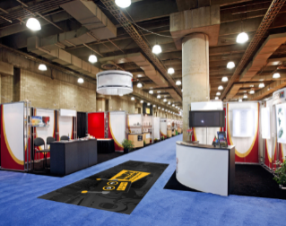
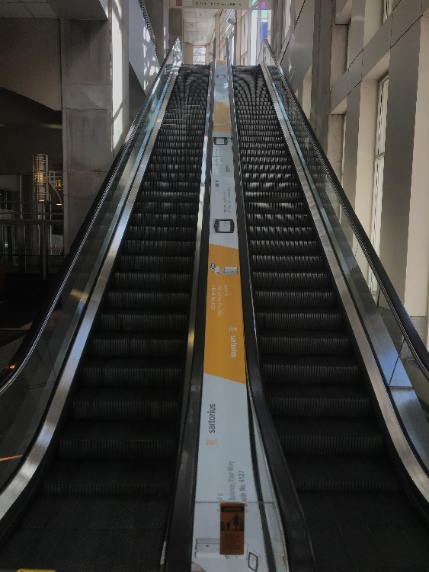
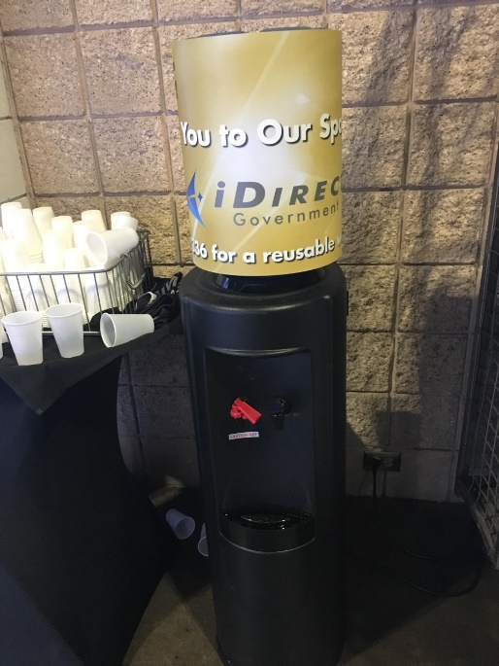
In-show Marketing Toolkit
Sponsorship Opportunities
Digital Brochures
Banner Advertisements
Final Program Advertisements
Publication Advertisements
Press Conferences
Press Lists
Press Releases

Slide 23
Exhibitor Success Tactics
Marketing Toolkit
Attendee Lists
Publication Ads
ROI Center
Marketing & Promotion
Measurement & Evaluation
Banner Ads
Final Program Ads
Digital Brochure
Press Conferences
Press Lists
Press Releases
Sponsorship Opportunities
Budgeting
Exhibiting Strategies
Exhibiting Checklist
2019 Standout Exhibitors
Exhibiting Webinars
Exhibiting Blogs
Ask an Expert
The “Marketing Toolkit” and “ROI Center” images above are hyperlinked to their respective Pittcon.org pages for your immediate access.

Slide 24
Sponsorships will allow you too…
retrieve leads before hitting the expo floor?
reach your
target market?
increase sales
and ROI?
drive traffic to
your booth?
enhance your
brand visibility?
stand out from your competition?
Notes:
If you are looking to do anything of the following, Pittcon 2020

Slide 25
Sponsorship Opportunities
Branding
Carpet Stickers
Water Coolers
Shuttle Bus Ribbons
Elevator Clings
Events
Pittcon Party (various sponsorships)
Welcome Reception
Mystify Station
“Your company’s” Headshot Lounge
Notes:
We broke down the sponsorships into 4 key types:
-Branding
-Digital
-Mobile App
-Events

Slide 26
Sponsorship Opportunities
Digital
Attendee Registration Package
Souvenir Inserts
Shuttle Bus Ribbons
Elevator Clings
Mobile App
Push Notifications
Rotating Banner Ad

Slide 27
Questions:
Many of your questions can be answered by visiting our website at www.Pittcon.org or contact marketing@Pittcon.org

